Slide 1
Forest Fire Detection
Using Object Detection and IoT

Slide 2
INTRODUCTION
The most common hazard in forest fires are accident as the forest themselves destroys the forests and can be great threat to wild life and peoples. The Internet of Things (IoT) is the physical device which is used to connect, store and enable the objects to collect information for exchanging the data through the cloud based system.
The main objective of project is to prevent the developing trend of the fire by monitoring temperature, humidity, etc. using various IoT sensors.

Slide 3
Working
The proposed mechanism can be used a threshold value of each sensor to validate the data and take initiative to avoid the prerequisite of achieving high reliability prevention using this mechanism.
The sensors uses IoT based applications for processing the gathered environmental data. Cloud computing, IoT sensors and wireless technology are combined for the purpose of fire detection in this project. In order to improve the accuracy of the system, integration of data processing schemes is done in this system.

Slide 4
Literature Survey

Slide 5
Paper Name | Month and Year of Publication | Inference
IoT based Forest Fire Detection System in Cloud Paradigm | 2021 | The most common hazard in forest fires are accident as the forest themselves destroys the forests and can be great threat to wild life and peoples. The Internet of Things (IoT) is the physical device which is used to connect, store and enable the objects to collect information for exchanging the data through the internet-based system.
Forest fire detection system based on wireless sensor network | May, 2009 | Based on the deficiencies of conventional forest fire detection on real time and monitoring accuracy, the wireless sensor network technique for forest fire detection was introduced, together with satellite monitoring, aerial patrolling and manual watching, an omni-bearing and stereoscopic air and ground forest-fire detection pattern was found.
Firoxio: Forest fire detection and alerting system | May, 2014 | This paper highlights the powerful feature of wireless sensor networks as a potential solution to the challenge of early detection of forest fires. The device presented makes use of various sensors attached, solar recharging mechanism, and wireless data transmission, to fulfill the task in question.

Slide 6
Background and Inferences

Slide 7
Forest fire detection has been a focus of many researchers for the last decade because of increased forest fire case reports from all over the world due to severe damage to society and the environment. Many methods have been proposed to detect forest fires, such as camera-based systems, WSN-based systems, and machine learning application-based systems, with both positive and negative aspects and performance figures of detection. Due to the higher probability of accurate and early detection due to the use of multiple sensor sources and deployment of sensor nodes in areas not visible to satellites, wireless sensor networks have a more positive outlook, and they have become the more applicable technology in many fields.
Many researchers have focused on environmental parameters, such as air temperature, relative humidity, barometric pressure, sound, light intensity, soil moisture, and wind speed and direction, along with gases, such as CO, CO2, methane, H2, and hydrocarbons apart from smoke, to detect forest fire conditions by considering the variations in these parameters during a fire and sensors have been selected according to the range, sensitivity, power consumption, and cost

Slide 8
Challenges
As supplying power to a sensor node is a challenging task in forested areas, utilizing only battery options is difficult because they do not last long, and distributing power using a wire would require a higher cost to deploy in a large forest. Therefore, many researchers have proposed solar-powered systems as secondary power sources along with rechargeable batteries as the main power source, while some researchers have proposed solar batteries because they last longer. To reduce the power consumption of sensor nodes, techniques such as keeping selected components active while others are deactivated have been proposed
Most WSN-based detection systems are centered around a base station due to the memory and processing limitations of the nodes. Important and partially processed data are transferred to the base station through wireless media for processing and enabling relevant actions, while the base station also acts as the gateway between the sensor nodes and the system user.

Slide 9
Technologies Used
IoT
ML
Wireless Sensor Network
YOLO5 Object Detection Model
Cloud
Storage, Processing and decesion making

Slide 10
Wireless Sensor Network
Wireless Sensor Network (WSN) is an infrastructure-less wireless network that is deployed in a large number of wireless sensors in an ad-hoc manner that is used to monitor the system, physical or environmental conditions. Sensor nodes are used in WSN with the onboard processor that manages and monitors the environment in a particular area. They are connected to the Base Station which acts as a processing unit in the WSN System. For our project any satellite based communication model is not ideal as the project expenditure is very high as they have to install each one of the units manually after finalizing the configuration and calibration. GPS devices consume more energy and reduce the nodes life time.
Hence, a low cost low power ZigBee based deployment is ideal.

Slide 11
ZigBee?
Zigbee is a standards-based wireless technology developed to enable low-cost, low-power wireless machine-to-machine (M2M) and internet of things (IoT) networks.
Zigbee is for low-data rate, low-power applications and is an open standard. This, theoretically, enables the mixing of implementations from different manufacturers, but in practice, Zigbee products have been extended and customized by vendors and, thus, plagued by interoperability issues. In contrast to Wi-Fi networks used to connect endpoints to high-speed networks, Zigbee supports much lower data rates and uses a mesh networking protocol to avoid hub devices and create a self-healing architecture.

Slide 12
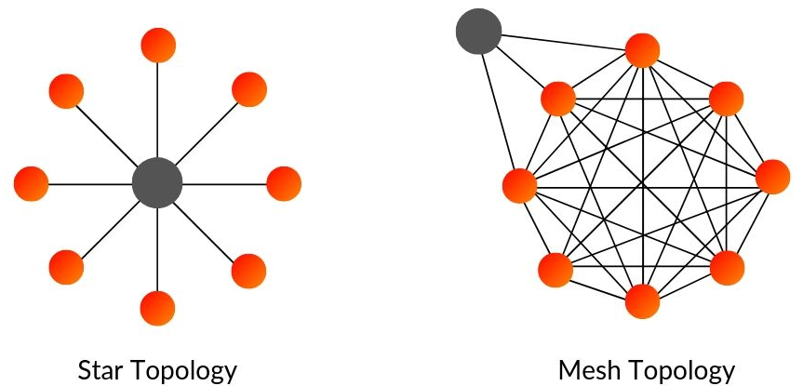
Topology used
IoT nodes can be deployed in a variety of ways depending upon the need, the type of sensors etc. for this particular scenario, a star topology with the smoke/heat detection nodes reporting to a central controller node, would be ideal.

Slide 13
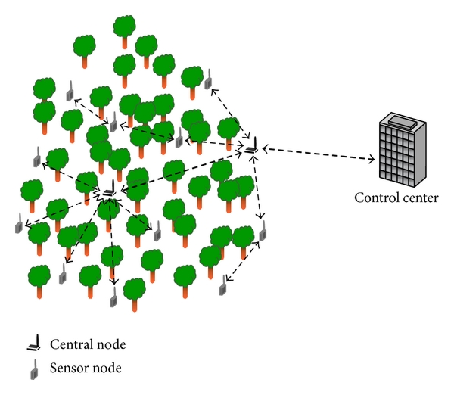
General Structure of the approach proposed.

Slide 14
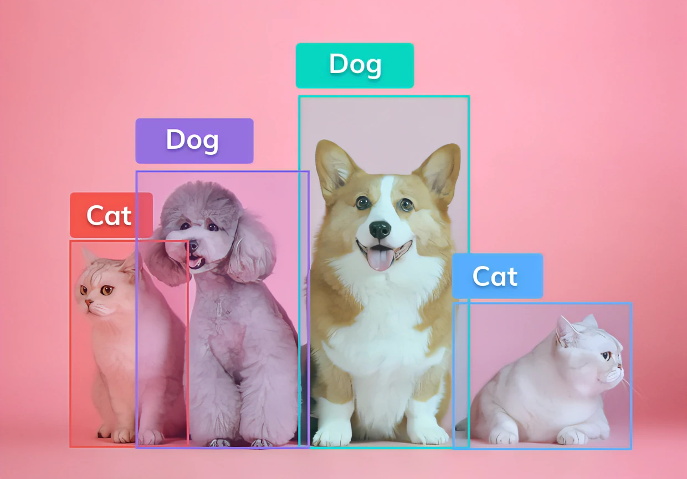
Image Recognition
Image detection, also known as image recognition or computer vision, is the ability of a computer or machine to identify and interpret objects, people, places, or patterns in digital images or videos. The technology uses various algorithms and machine learning models to analyze the visual features of an image, such as shape, color, texture, and patterns, and then make decisions based on that analysis.

Slide 15
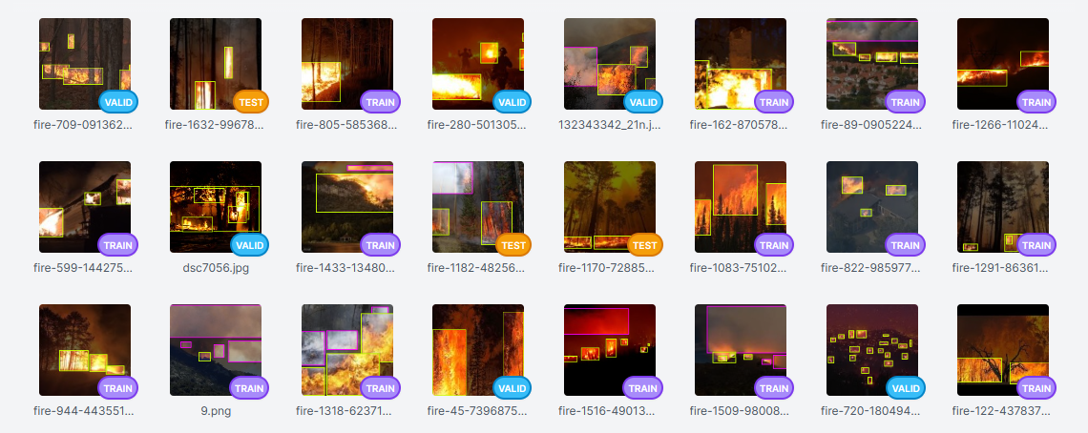
Dataset

Slide 16
Endpoint Devices

Slide 17
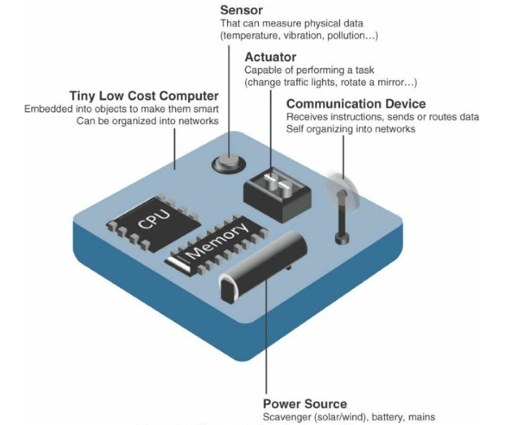
Smart Object
A smart object, is a device that has, at a minimum, the following four defining characteristics

Slide 18
Smart Objects Used (Sensor)
Device Name | Type of Sensor | Working
Smoke Detector | Chemical | Ionization-type smoke alarms have a small amount of radioactive material between two electrically charged plates, which ionizes the air and causes current to flow between the plates.
Heat Sensor | Temperature | The temperature sensor uses radiation on and convection for monitoring the changes in the temperature. The non-contact temperature sensor can be used to detect the gases and liquids that emit radiant energy, which is transmitted in the form of infra-red radiation.
Hygrometer | Humidity | Humidity is defined as the amount of water present in the surrounding air. This water content in the air is a key factor in the wellness of mankind.

Slide 19
Architecture

Slide 20
IoT deployment Model
We are using a level 5 IoT system, as the data is big and computationally intensive
A level-5 IoT system has multiple end nodes and one coordinator node.
The end nodes that perform sensing and/or actuation.
Coordinator node collects data from the end nodes and sends to the cloud.
Data is stored and analyzed in the cloud and application is cloud-based.

Slide 21
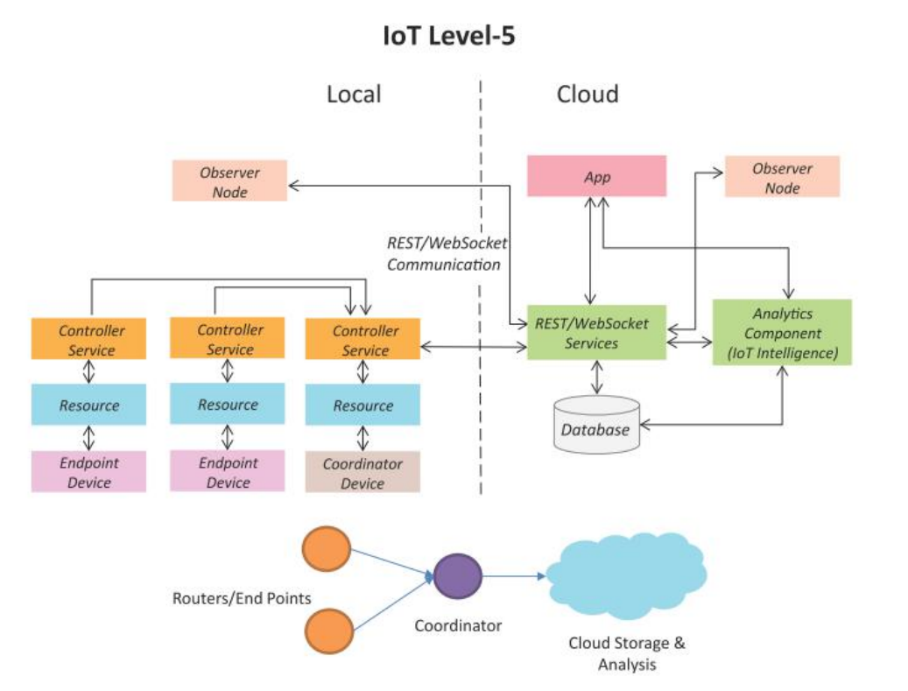
Level 5 IoT System

Slide 22
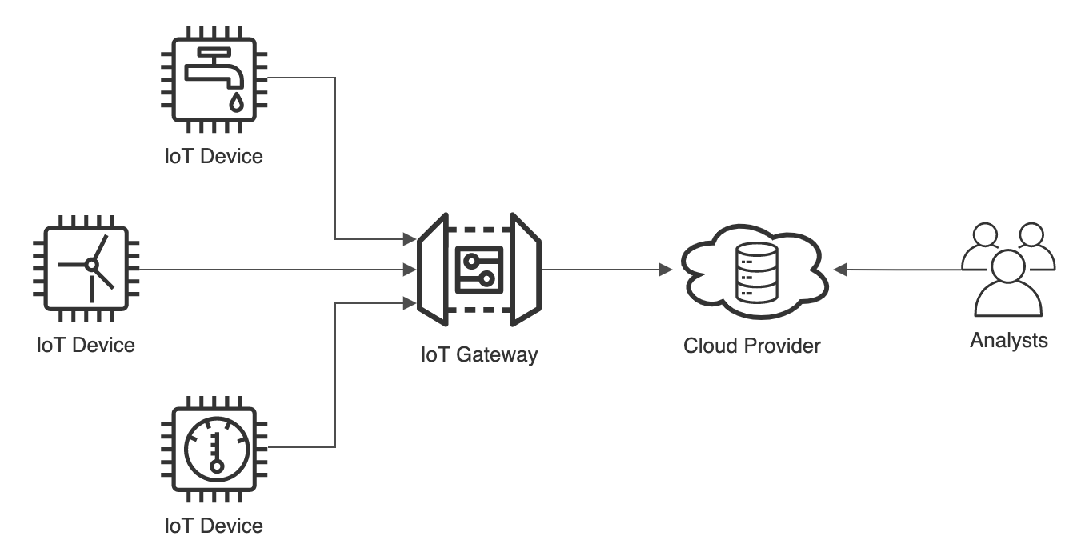
Data Flow

Slide 23
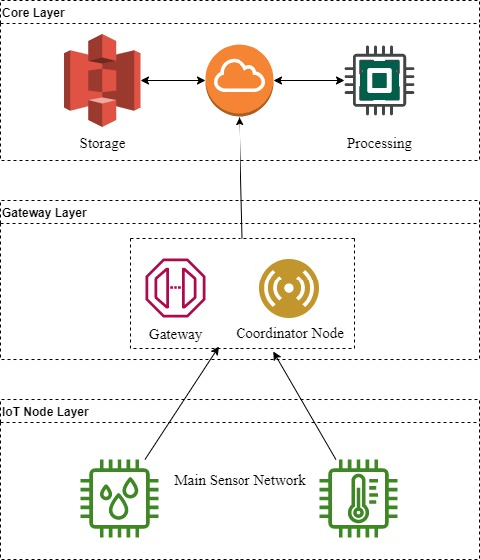
Architecture
The relationship between Cloud Computing in Internet of Things (IoT) is a symbiotic one, as each technology complements and supports the other. IoT brings the power of Big Data and real-time analytics to a wide variety of devices and sensors. At the same time, Cloud Computing provides the scalable infrastructure and computing resources needed to process and manage this data. Together, these technologies are helping businesses to achieve greater efficiency, optimize operations, and improve decision-making.
In our project the raw data generated by sensors is passed to the Cloud layer through the gateway where it can be Processed and analyzed for appropriate decision making.

Slide 24
Conclusion and future scope
In this project, an IoT Infrastructure for forest fire detection system has been designed to detect fire at earlier stage. The most important objective in fire surveillance is early and reliable detection and localization of the fire. The data collected through different sensors located at different locations and information will be sent to Control modules placed in various places.
In future, we can develop this model to minimize the energy consumption of all sensors and complete networks considering the node distribution among clusters.

Slide 25
Thank You!
Anurag Singh (RA2011029010012)
Naman Anand (RA2011029010013)
Arnav Kandhari (RA2011029010024)

